Slide 1
Testning Bell inequality for Higgs Boson decay
PANTZARE, Axel Daniel Fredrik
1155173267

Slide 2
Outline
Background
Theory
Higgs boson
Bell inequality
Method
Results
Discussion

Slide 3
Background
LHC the worlds largest and most powerful particle.
Consist of a 27 km ring with supercooled magnets.
Mostly used with protons.
Collision energy has increased from 7 TeV to 13 TeV
Operational since 2008.
ATLAS – Largest general-purpose detector at LHC.
Designed to detect masses, energies, lifetimes, momentum, charges and spins

Slide 4
Background
A variety of particles produced
I am mostly interested of the Higgs when decaying to two W bosons
Higgs Bosons can be formed in a variety of ways.
Gluon fusion
Vector Boson Fusion (VBF)
Higgs Strahlung
Top Fusion
Higgs Strahlung and Top Fusion are both smaller than the two others and have very minor contributions and are therefore negelected.

Slide 5
Backround
ATLAS uses a cylindrical coordinate system
The x-axis is towards the middle of the ring
The y-axis is upwards
The z-axis is in the direction of the beam (circumferance)

Slide 6
Theory – Higgs backround
Gauge Invariance and symmetries give rise to the force carriers or the gauge bosons
These are predicted to be massless which they are not observed to be.
Therefore, something else was needed to give them mass and complete the standard model.

Slide 7
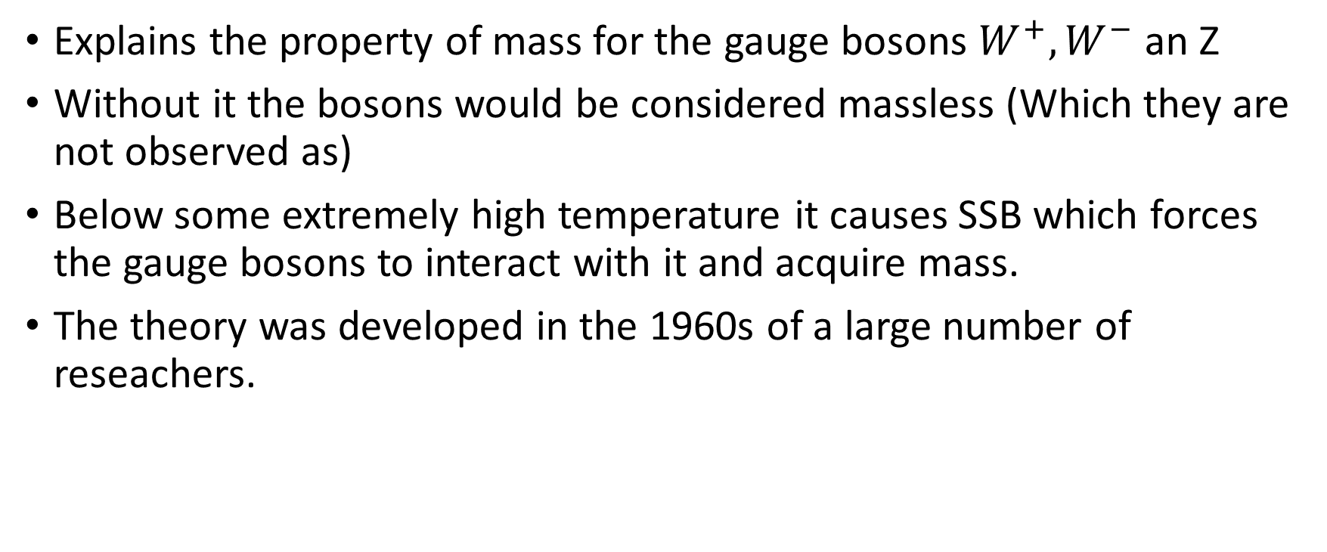
Theory – Higgs mechanism

Slide 8
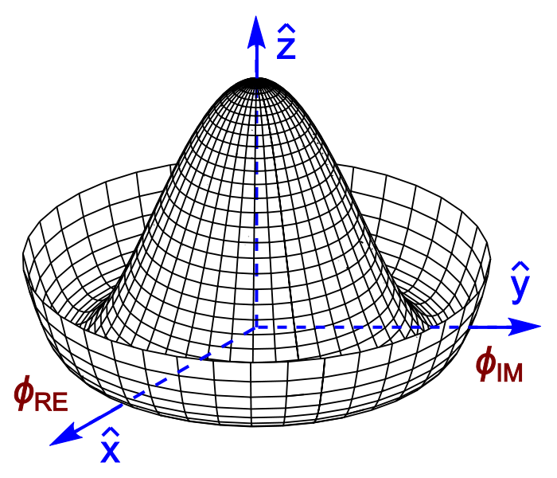
Theory – Higgs field
Is needed in the standard model break the symmetry of the electroweak force.
Adds a non-zero SU(2) scalar field
Solve the gauge invariance problem
Excitations in the Higgs field gives rise to both Higgs boson and goldstone boson
Without this field the gauge bosons would not have any mass and travel at the speed of light.

Slide 9
Theory – Higgs boson
Different interactions gives different masses of particles.
The p-p collisions in a collider excites the higgs field and creates the boson
Detected in 2012 by ATLAS, the paper about it released in 2013.
Has no spin, charge color and positive parity

Slide 10
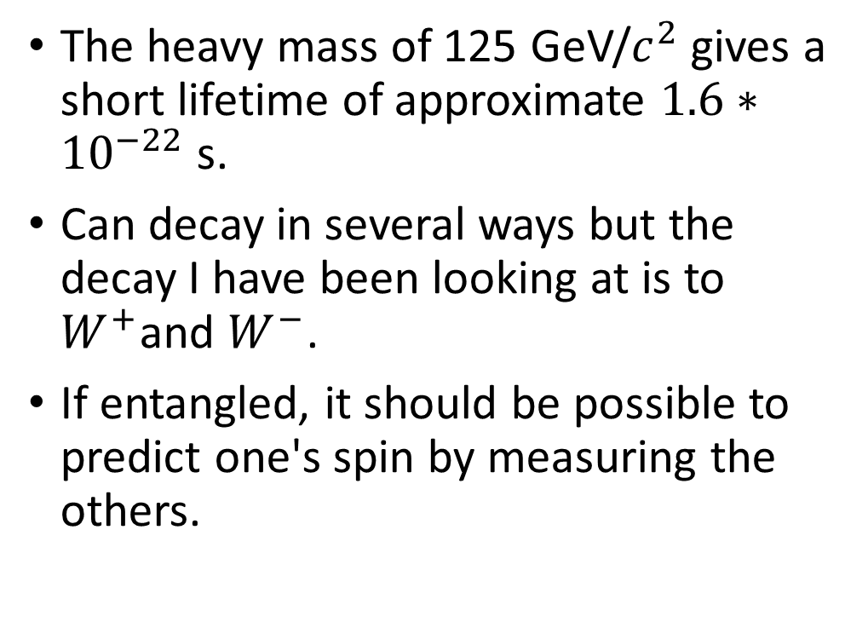
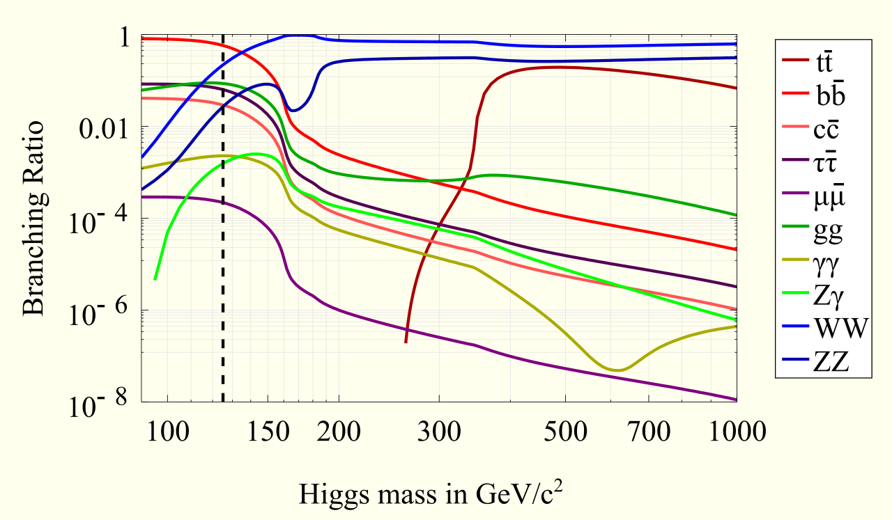
Theory – Higgs boson decay

Slide 11
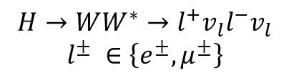
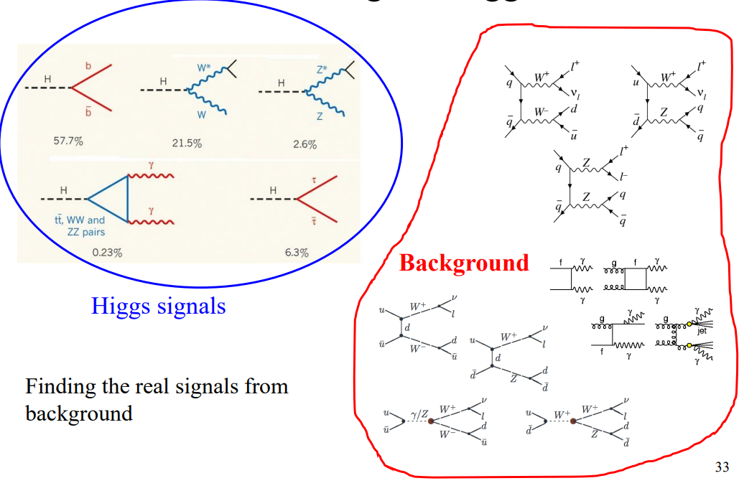
Theory – Higgs particle decay
Searching for two differently charged leptons that is not the same type to avoid Z

Slide 12
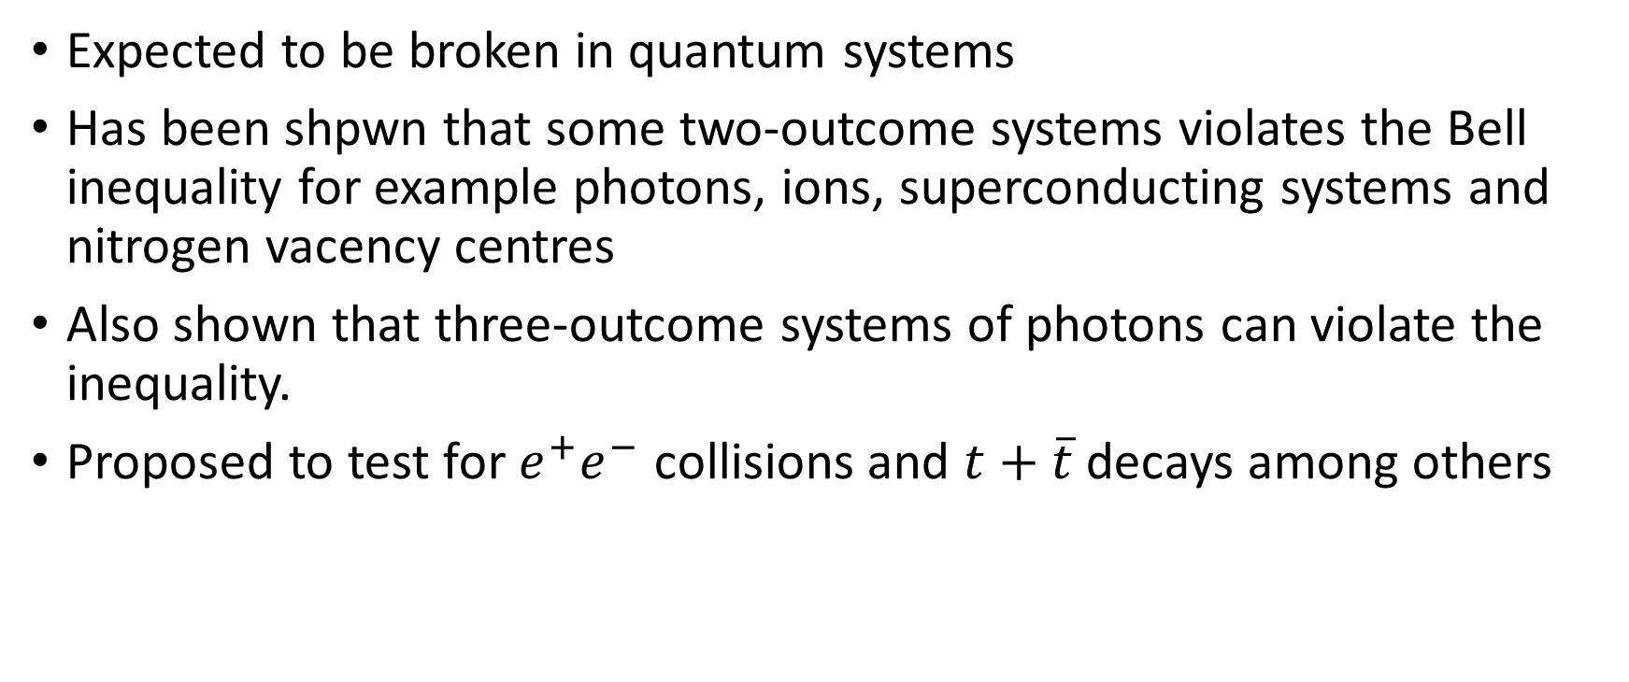
Theory – Bell inequality

Slide 13
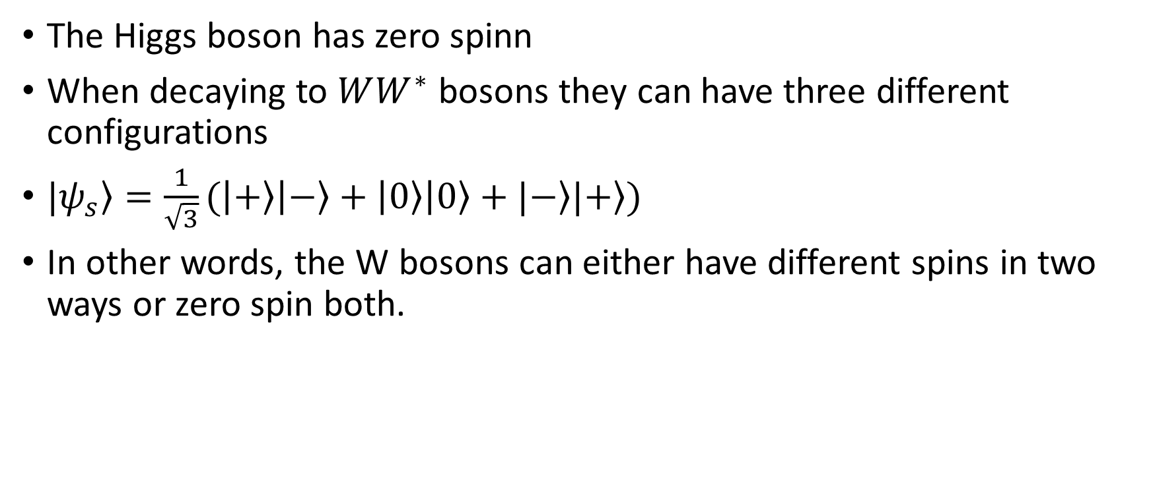
Theory – Three outcome systems

Slide 14
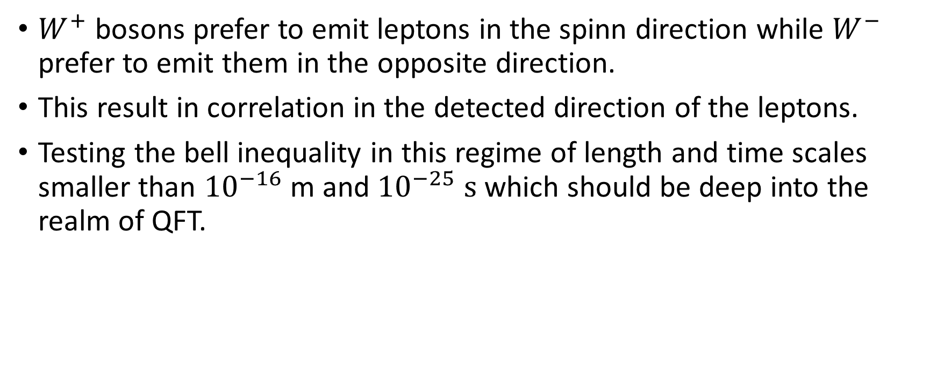
Theory – Bell inequality

Slide 15
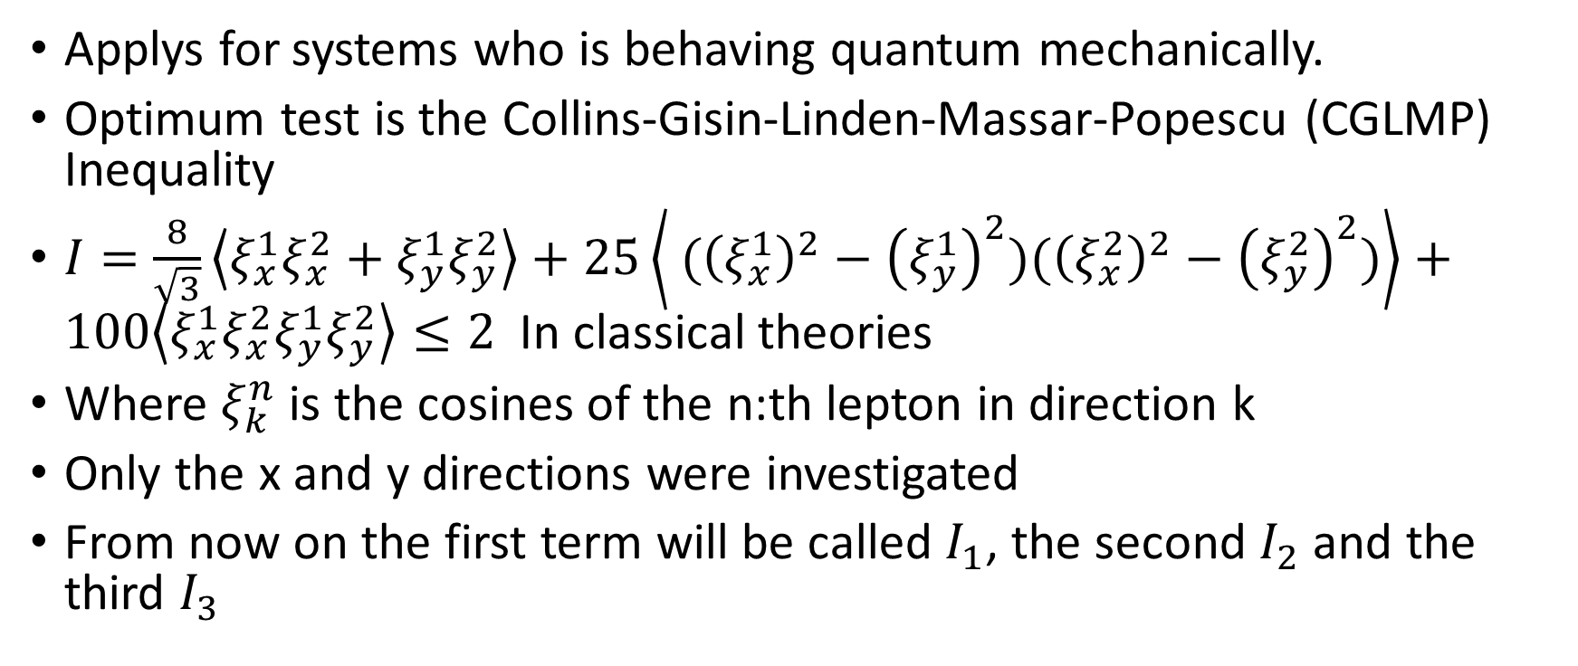
Theory – Bell inequality

Slide 16
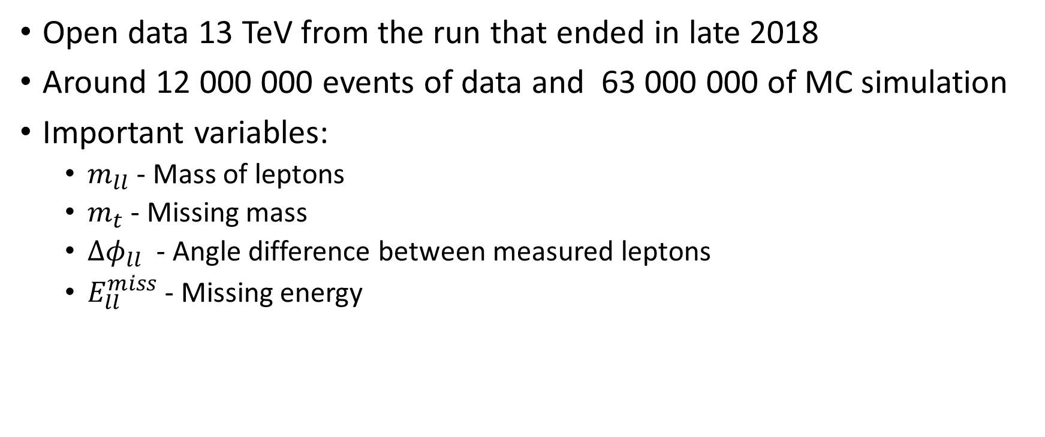
Method – Data set

Slide 17
Method – Execution
Investigate parameters by themselves, finding correlations
Comparing data and simulation to predict where the S/(S+B) ratio is the highest and optimize the selection for that
Calculate the I value for both simulation in different configurations and data to compare.

Slide 18
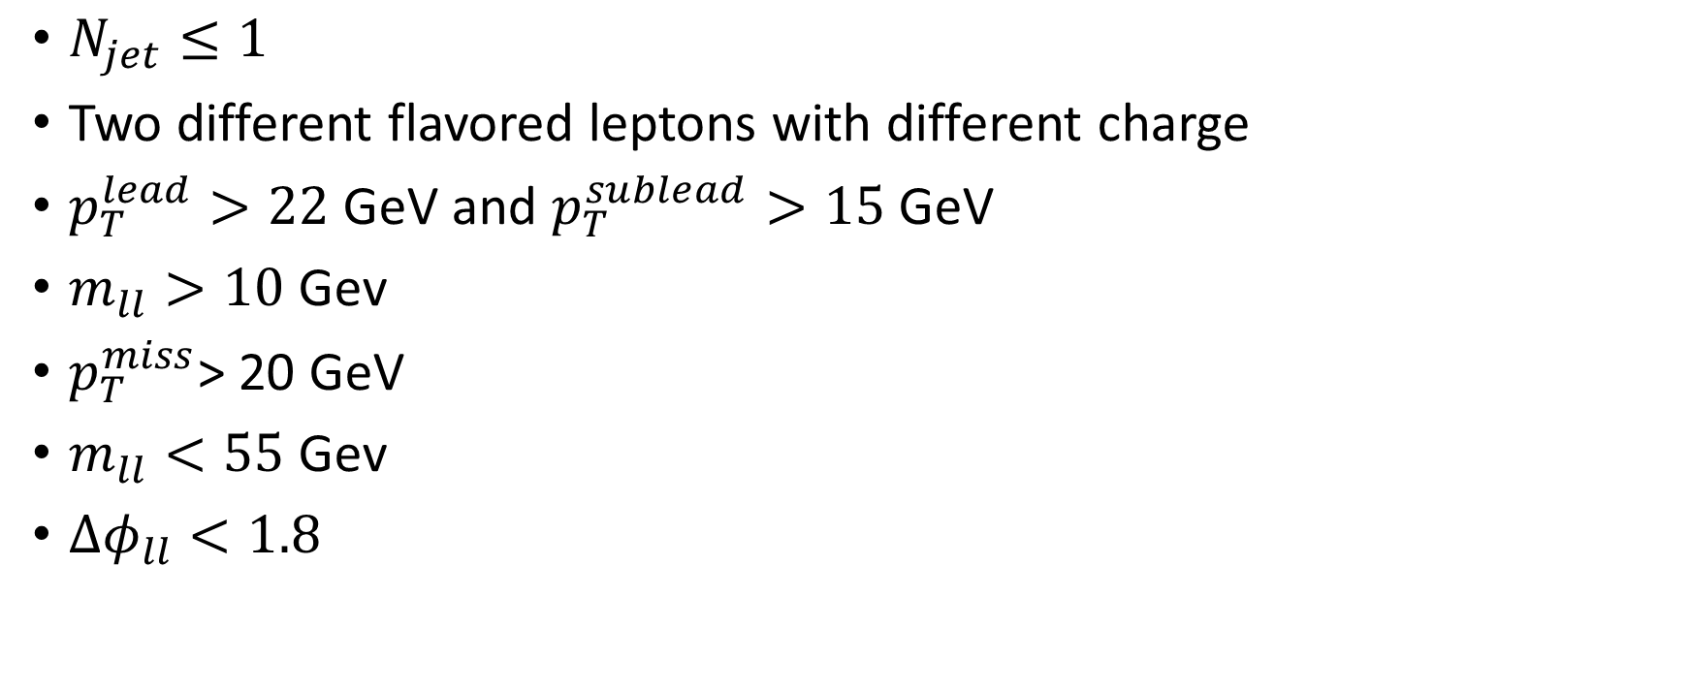
Initial constraints

Slide 19
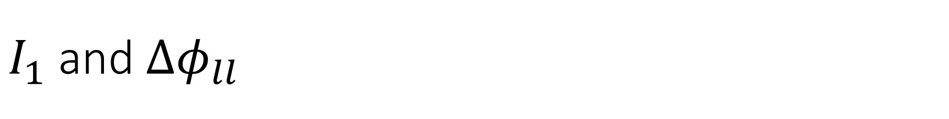
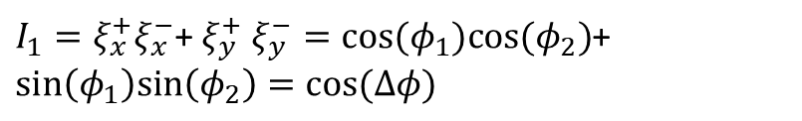
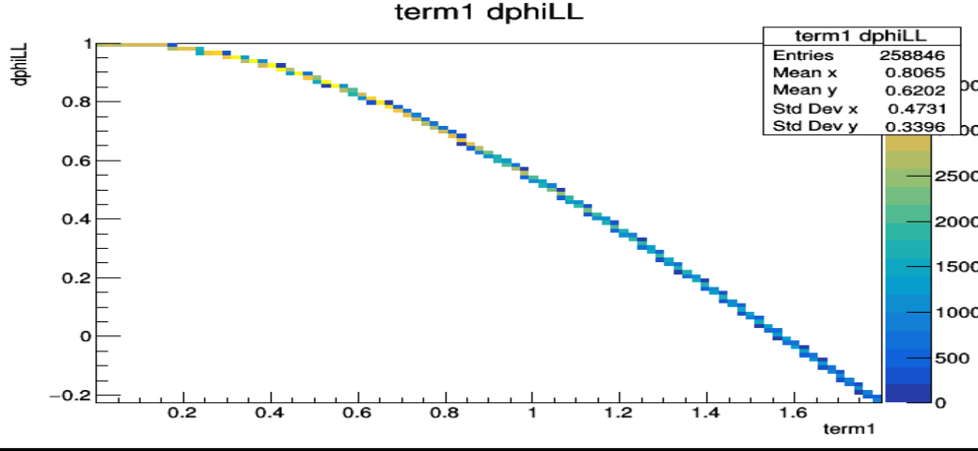

Slide 20
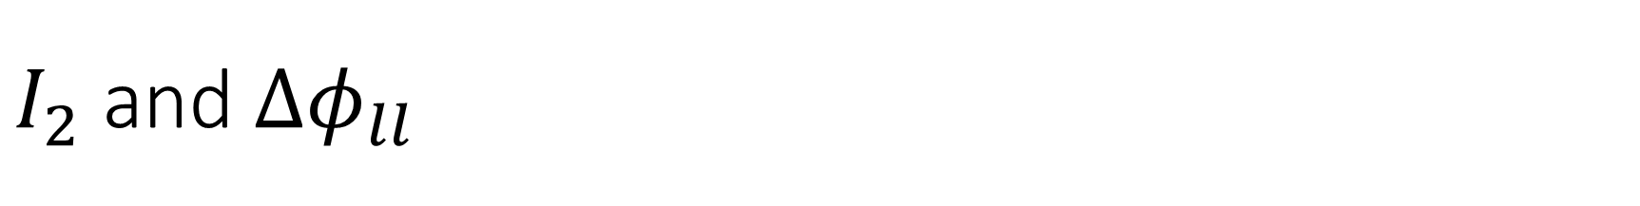
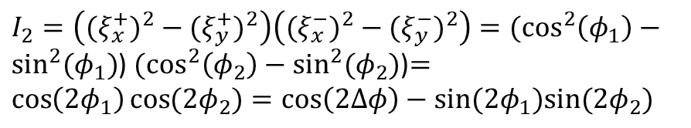
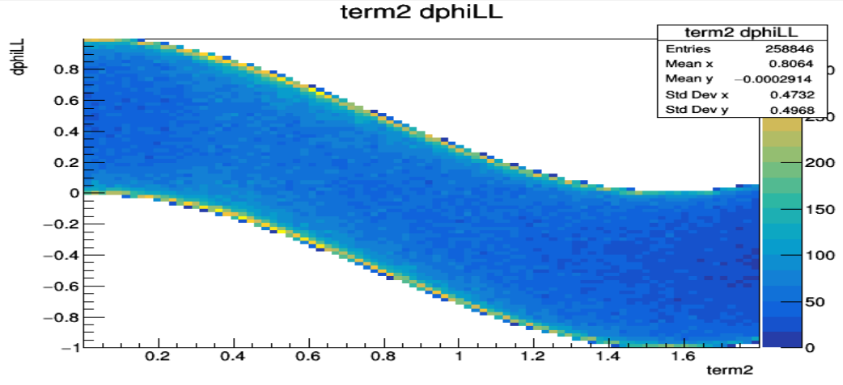

Slide 21
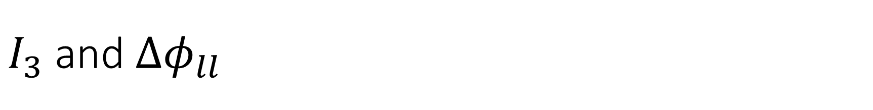
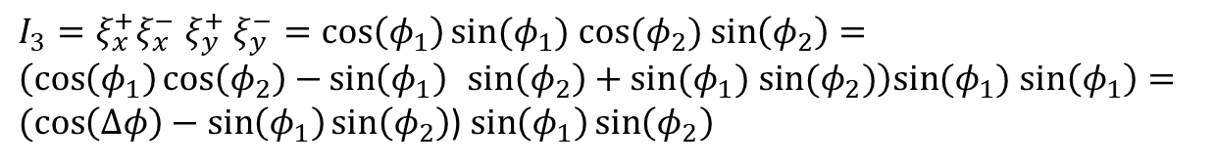
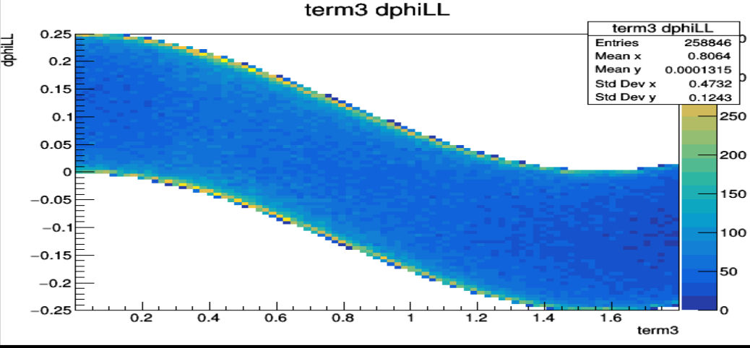

Slide 22

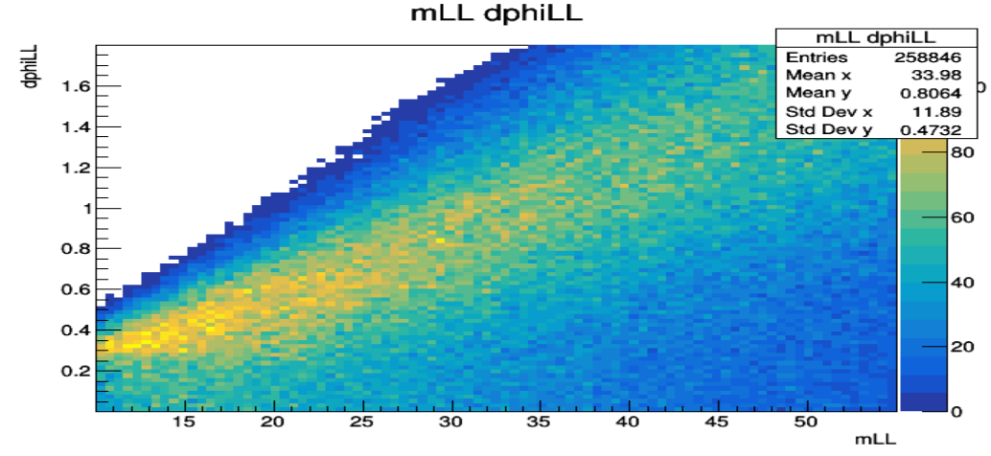

Slide 23
Algorithm to decide new cuts
Relax the constraints of one varible at the time
If the S/(S+B) drops below ½ of the maximum value, make a cut there
Repeat until there is no more varibles where the SB value drops below ½ of the max

Slide 24
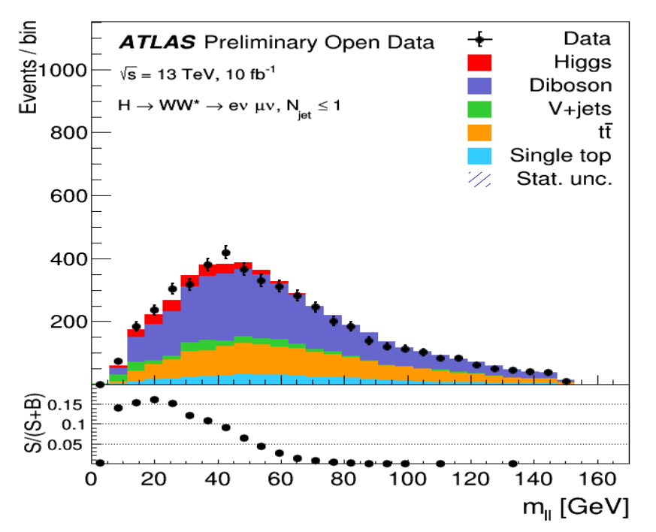
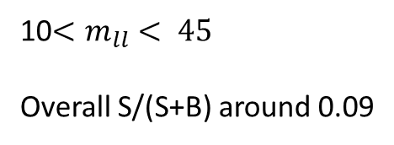
First cut

Slide 25
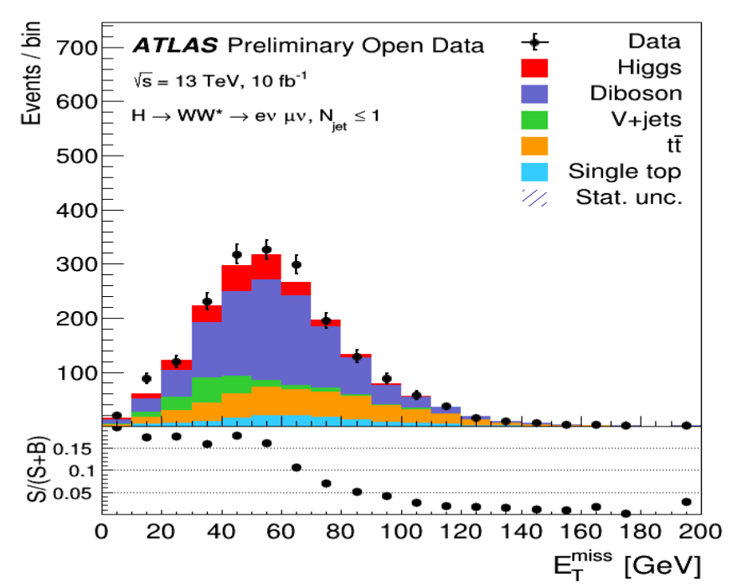
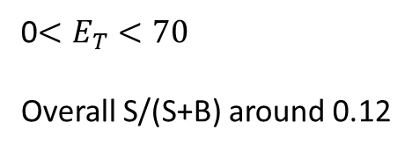
Second cut

Slide 26
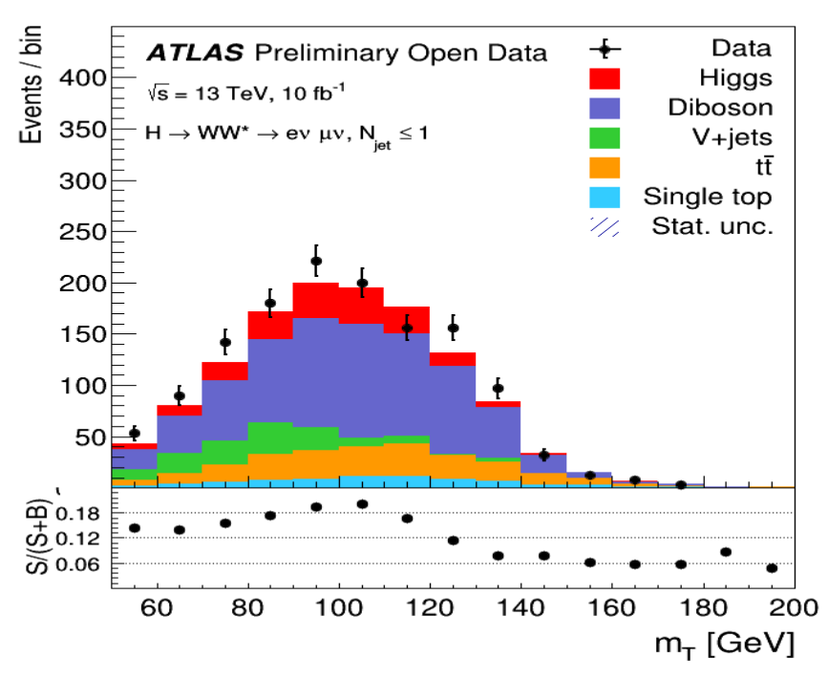
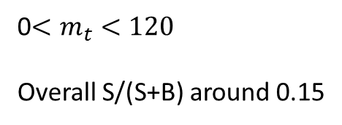
Third cut

Slide 27
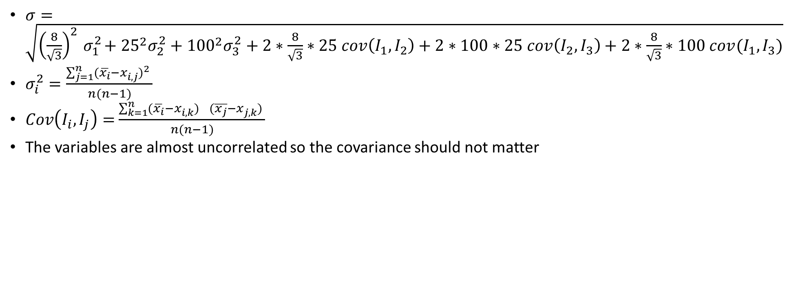
Calculation of error

Slide 28
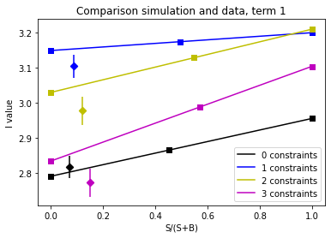
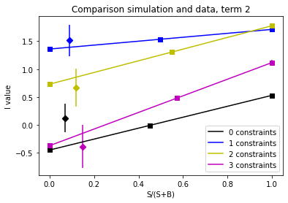
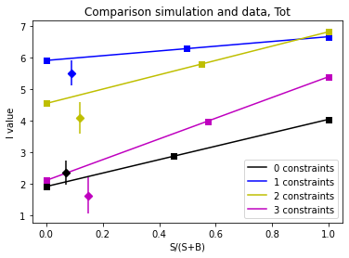
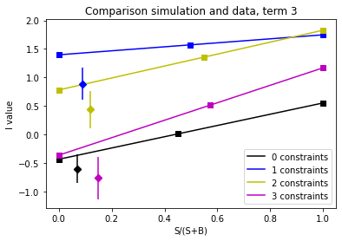
Splitting to compare each constraint individually

Slide 29
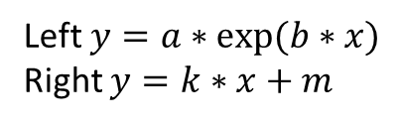
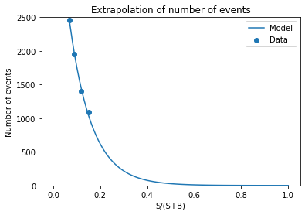
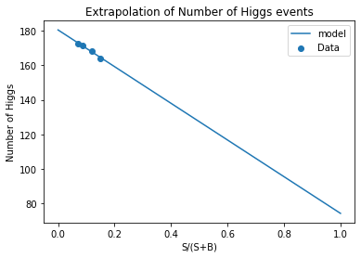
Decrease of number of events with increasing S/(S+B)

Slide 30
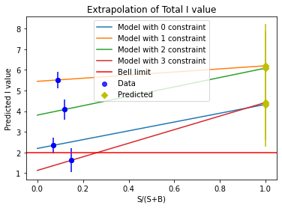
Extrapolation of I value

Slide 31
Error analysis
Only statistical error considered in my calculations.
Systematic and errors from the measurement should also be considered. There are more errors in the data than the statistical as seen on slide 25.
This would further reduce the confidence level.

Slide 32
Discussion
The data having smaller I values could suggest that it is less likely to break the Bell inequality.
The one to two sigma confidence level gives a hint of that there is something here.
The method used is not optimal because the cuts made is influencing the I value significantly, makes the backround break the inequality which is not expected.

Slide 33
Future work
MVA could be useful to get higher S/(S+B) ratio and make the analysis more rigid.
More data would decrease the error and therefore make the values more reliable.
Further investigations of the differances between the simulation and data is needed.

Slide 34
References
Alan J. Barr “Testing the bell inequalities in Higgs boson decays”
https://en.wikipedia.org/wiki/Higgs_mechanism#Structure_of_the_Higgs_field
https://en.wikipedia.org/wiki/Higgs_boson#Gauge_invariant_theories_and_symmetries
https://en.wikipedia.org/wiki/Large_Hadron_Collider
https://en.wikipedia.org/wiki/ATLAS_experiment#ATLAS_detector
Lecture notes from PHYS5560

